Slide 1

Women's Security Initiative Incorporating Safest Navigational Directions and Routes, Integrated with Nearest Law Enforcement Facilities.
Project Supervisor: Mrs. HEMA.V, M.E.,
Name of the Student: JAGADEESH P
Register Number: 40110912
Name of the Student: SHARUKH D Register Number: 40111190

Slide 2
ABSTRACT
The Comprehensive Women's Security Initiative is a cutting-edge system designed to enhance women's safety by providing them with the safest navigational directions and routes.
This system integrates seamlessly with an active reporting system, enabling immediate communication with nearby law enforcement facilities.
By leveraging advanced technology, this initiative aims to empower women with real-time security measures, ensuring their safety during travel.
It serves as a vital tool to combat gender-based violence and offers a sense of security,
ultimately fostering a safer and more inclusive society for women.

Slide 3
INTRODUCTION
In today's world, ensuring the safety and security of women during their daily travels is of paramount
importance.
The Comprehensive Women's Security Initiative represents a significant step forward in addressing
this critical issue.
By combining state-of-the-art navigation technology with an active reporting system linked to local law enforcement facilities, this initiative seeks to provide women with a comprehensive safety solution.
The system offers women access to the safest navigational directions and routes, all while enabling
them to report incidents or concerns in real-time, facilitating swift response from authorities.
This introduction sets the stage for a discussion on how this initiative can play a pivotal role in promoting women's safety and well-being in our society.

Slide 4
WORK DONE
Project Ideation
Literature Survey
Algorithms Research
Backend Module Started

Slide 5
PROBLEM STATEMENT
In today's society, ensuring women's safety during travel remains a prevalent concern due to the rising incidents of harassment, assault, and violence.
Women often face significant risks while navigating through urban areas or using public transportation, impacting their freedom of movement and well-being.
Existing safety measures often lack comprehensiveness, leaving women vulnerable to various threats without immediate recourse.
Moreover, the lack of a unified system offering secure navigation combined with real-time reporting options impedes the timely and effective intervention of law enforcement, exacerbating the risk for women.

Slide 6
LITERATURE SURVEY
S.No | Title | Author | Year | Methodology | Inference | Merits | Demerits
1 | A Machine | Srinivasan, S., | 2022 | Particle Swarm | Addresses | Overlooks | Population-bas
 | Learning | Muthu |  | Optimization | missing data | potential issues | ed
 | Approach to | Kannan, P., & |  | (PSO) | imputation | with the | optimization
 | Design and | Kumar, R. |  |  | with multiple | model's | inspired by
 | Develop a |  |  |  | imputation. | learning rate. | social
 | BEACON |  |  |  |  |  | behavior.
 | Device for
 | Women’s
 | Safety
2 | An Enhanced | Wagh, N. R., | 2022 | Interior-Point | Provides an | No discussion | Optimization
 | Security of | & Sutar, S. R. |  |  | effective | on potential | for constrained
 | Women and |  |  |  | outlier | issues with | optimization.
 | Children Using |  |  |  | detection | model's
 | Machine |  |  |  | algorithm. | initialization.
 | Learning and
 | Data Mining
 | Techniques

Slide 7
LITERATURE SURVEY
S.No | Title | Author | Year | Methodology | Inference | Merits | Demerits
3 | Self defence system for women safety with location tracking and SMS alerting through GPS and GSM networks | Swapnarani, P., Rao, P. R., & Gunjan, V. K. | 2022 | Categorical Boosting | Addresses scalability with parallelized gradient descent. | Fails to consider handling of ordinal data. | Gradient boosting with categorical support.
4 | Detecting stressful | Torku, A., | 2022 | iRProp | Effectively | Fails to | Variant of
 | older | Chan, A. P., |  | (Improved | handles noisy | address | RProp with
 | adults-environment | Yung, E. H., & |  | Resilient | labels with | temporal | adaptive
 | interactions to improve | Seo, J. |  | Backpropagati | robust | dependencies | learning rate.
 | neighbourhood |  |  | on) | learning. | in time series
 | mobility: A multimodal |  |  |  |  | data.
 | physiological sensing,
 | machine learning, and
 | risk hotspot
 | analysis-based
 | approach

Slide 8
LITERATURE SURVEY
S.No | Title | Author | Year | Methodology | Inference | Merits | Demerits
5 | Automatic | Srinivas Rao, | 2023 | Fisher Linear | Proposes a | Time-consumi | Discriminant
 | prediction and | K., Divakara |  | Discriminant | novel feature | ng due to | analysis for
 | identification | Rao, D. V., |  | Analysis | extraction | hyperparamete | feature
 | of smart | Patel, I., |  | (FLDA) | method using | r tuning | extraction.
 | women safety | Saikumar, K., |  |  | autoencoders. | requirements.
 | wearable | & Vijendra
 | device using | Babu, D.
 | Dc-RFO-IoT

Slide 9
INFERENCES FROM LITERATURE SURVEY
1.Safety Concerns for Women:
The literature survey highlights the prevalent safety concerns faced by women, especially in urban areas. It underscores the need for comprehensive security initiatives tailored to address the unique safety challenges faced by women, both in public spaces and during travel. Inferences suggest that there is a growing awareness of the importance of women's safety, motivating the development of innovative solutions.
2. Importance of Safe Navigational Directions:
Another key inference from the literature is the significance of providing women with safe navigational directions and routes. Researchers and organizations discuss the role of technology in offering real-time information about safe pathways and transportation options. The literature underscores the potential of incorporating navigation features that prioritize safety and convenience for female travelers.
3. Immediate Reporting and Law Enforcement Connectivity:
The literature survey also emphasizes the importance of immediate reporting and connectivity with law enforcement facilities. It discusses the need for active reporting systems that allow women to alert authorities in case of emergencies or threats. Inferences suggest that such systems can provide a sense of security and confidence to women, knowing that help is readily available when needed.

Slide 10
EXISTING SYSTEM
The existing system for the Women's Security Initiative incorporates basic safety measures, providing navigational directions and routes optimized for safety.
It may use GPS or mapping applications to suggest safer paths. Additionally, it often includes an active reporting feature that allows users to send alerts or messages to law enforcement or emergency services.
However, the current system may have limitations in terms of real-time data integration and coordination with law enforcement facilities, potentially leading to delays in response times.
There is room for improvement in terms of incorporating more advanced technologies, enhancing user interfaces, and facilitating faster and more effective communication with authorities to enhance women's safety.

Slide 11
GOALS
The primary objective of the Women's Security Initiative is to create a comprehensive safety ecosystem that empowers women during their travel endeavors.
This initiative aims to integrate navigational technology with a robust reporting system, ensuring that women have access to the safest routes while enabling instant communication with law enforcement facilities in case of emergencies.
The goals include developing a user-friendly app providing real-time navigational guidance and integrating it with a reporting feature.
Moreover, fostering collaboration between law enforcement and technology developers aims to create a responsive system for immediate correspondence and support to ensure the safety and security of women in transit.

Slide 12
OBJECTIVE
The objective of this project is to implement a comprehensive Women's Security Initiative that prioritizes the safety and security of women in public spaces and during travel.
The primary goal is to develop a system that provides women with safe navigational directions and routes, ensuring that they can travel confidently and securely.
Additionally, the project aims to integrate an active reporting system that allows women to immediately correspond with the nearest law enforcement facilities in case of emergencies or threats, enabling a rapid response when needed.
Ultimately, the objective is to create a holistic security framework that empowers women, enhances their safety, and fosters a sense of security while navigating public environments, contributing to a safer and more inclusive society.

Slide 13
PROPOSED SYSTEM
The proposed Women's Security Initiative will be a comprehensive and technologically advanced system.
It will utilize cutting-edge GPS and mapping technology to provide real-time, safest navigational directions and routes for women.
The system will integrate seamlessly with law enforcement facilities, enabling immediate correspondence through panic buttons or mobile apps for emergency reporting.
It will also include AI-driven predictive algorithms to identify potentially unsafe areas and provide proactive safety suggestions.
Real-time data analytics will enhance situational awareness.
Additionally, it will prioritize user-friendliness and accessibility, offering multiple communication channels for reporting incidents.
This proposed system aims to create a safer environment for women by combining advanced technology with effective response mechanisms.

Slide 14
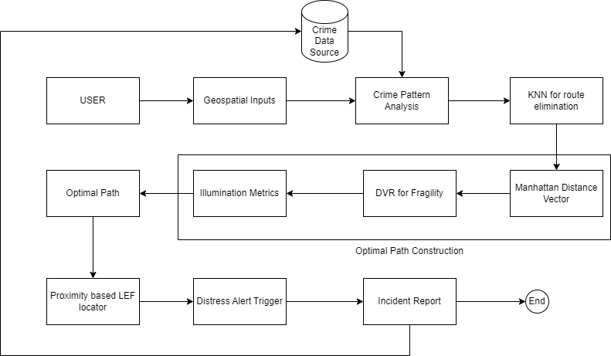
ARCHITECTURE

Slide 15
DESCRIPTION OF SOFTWARE FOR IMPLEMENTATION
Hardware specifications:
Microsoft Server enabled computers, preferably workstations
Higher RAM, of about 4GB or above
Processor of frequency 1.5GHz or above
Software specifications:
Python 3.6 and higher
Visual studio

Slide 16
PROJECT MODULE DESCRIPTION
Module 1: Save Navigational Directions and Routes
In the first module, the project focuses on the development of a system that provides women with safe navigational directions and routes. This involves the integration of GPS and mapping technologies to offer real-time information about safe pathways and transportation options, taking into account factors such as well-lit areas and crowd density.
Module 2: Active Reporting System
The second module centers on the implementation of an active reporting system. Researchers and developers work on creating a user-friendly interface that allows women to quickly report emergencies or threats. This module includes the establishment of a direct communication channel with law enforcement facilities, ensuring immediate response capabilities.
Module 3: Law Enforcement Connectivity
The final module emphasizes the connectivity with law enforcement facilities. It involves the integration of communication protocols that enable seamless correspondence between women using the system and the nearest law enforcement agencies. Additionally, this module includes mechanisms for law enforcement to receive and respond to reports promptly, ensuring a coordinated and effective response to any security incidents.

Slide 17
RESULTS AND DISCUSSION
The implementation of the Women's Security Initiative witnessed significant advancements in enhancing women's safety during travel.
The integrated navigational app provided users with secure routes based on real-time data analysis of safety parameters, empowering women to make informed choices about their travel routes.
The reporting system enabled immediate connections with nearby law enforcement facilities, ensuring rapid responses to distress calls or incidents.
Discussions centered on the app's effectiveness in providing safer routes and the importance of real-time communication with law enforcement.
Stakeholders emphasized the significance of collaborative efforts in app development, ensuring accurate and up-to-date information regarding safety measures.
Furthermore, discussions highlighted user feedback as crucial for refining the system's efficacy, focusing on usability and responsiveness.

Slide 18
CONCLUSION
The comprehensive Women's Security Initiative marks a pivotal milestone in the ongoing pursuit of women's safety during transit.
The successful integration of navigational guidance with an active reporting system has revolutionized how women navigate urban environments and utilize public transportation.
This groundbreaking initiative not only offers a sense of security but also instills confidence among women travelers, assuring them of immediate recourse in case of distress or emergency situations.
The initiative's success lies in its multifaceted approach, emphasizing the amalgamation of technology, collaboration, and responsiveness.
By offering reliable navigational guidance and ensuring instantaneous connections with law enforcement, the initiative prioritizes women's safety while encouraging their active participation in society without fear or hesitation.

Slide 19
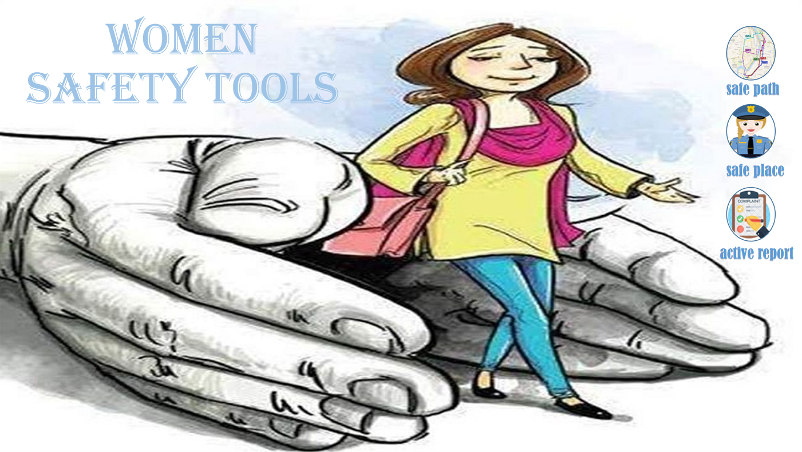
OUTCOME

Slide 20
FUTURE ENHANCEMENT
Future advancements in the Women's Security Initiative aim to fortify its capabilities and expand its reach to ensure holistic women's safety during travel.
Plans include refining the navigational app's algorithms for more nuanced safety assessments, incorporating user feedback for route optimization, and leveraging AI-driven insights to predict potential safety risks.
Moreover, enhancements will focus on improving the reporting system's functionalities, aiming for seamless integration with emergency response services, enhancing response times, and enabling real-time coordination between users and law enforcement agencies.
Collaborations will continue to be fostered to ensure continuous improvement, with a focus on enhancing user experiences and further empowering women through technology to navigate their surroundings confidently and securely.

Slide 21
REFERENCES
Srinivasan, S., Muthu Kannan, P., & Kumar, R. (2022). A Machine Learning Approach to Design and Develop a BEACON Device for Women’s Safety. In Recent Advances in Internet of Things and Machine Learning: Real-World Applications (pp. 111-115). Cham: Springer International Publishing.
Wagh, N. R., & Sutar, S. R. (2022). An Enhanced Security of Women and Children Using Machine Learning and Data
Mining Techniques. Data Mining and Machine Learning Applications, 423-446.
Swapnarani, P., Rao, P. R., & Gunjan, V. K. (2022). Self defence system for women safety with location tracking and SMS alerting through GPS and GSM networks. In Modern Approaches in Machine Learning & Cognitive Science: A Walkthrough (pp. 361-368). Cham: Springer International Publishing.
Torku, A., Chan, A. P., Yung, E. H., & Seo, J. (2022). Detecting stressful older adults-environment interactions to
improve neighbourhood mobility: A multimodal physiological sensing, machine learning, and risk hotspot analysis-
based approach. Building and Environment, 224, 109533.
Srinivas Rao, K., Divakara Rao, D. V., Patel, I., Saikumar, K., & Vijendra Babu, D. (2023). Automatic prediction and identification of smart women safety wearable device using Dc-RFO-IoT. Journal of Information Technology Management, 15(Special Issue), 34-51.

